Slide 1
Lecture 9: Stream-network spatial models
May 22, 2018
Learning goals:
Understand how to specify a spatial model on a stream network
Implement and explore model to estimate spatial variation in detection probability

Slide 3
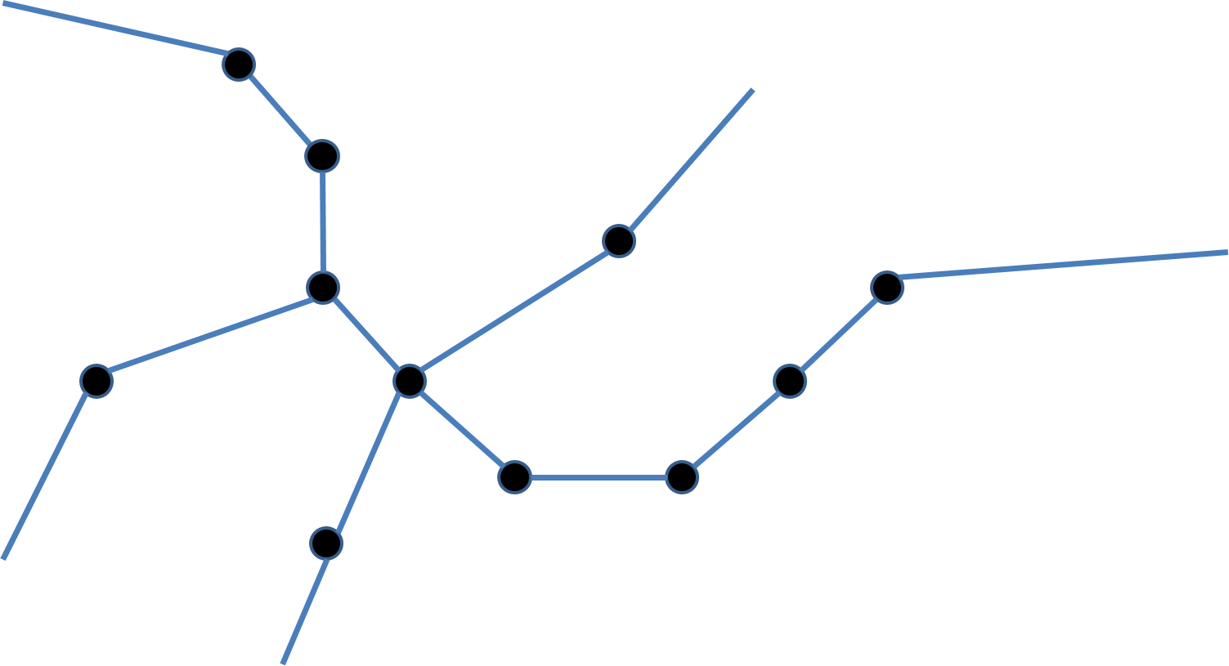
Stream networks
Imagine you have samples on a stream network

Slide 4
Stream networks
How to estimate detection probability?
Design an experiment with replicated sampling!
Closed-population tag-recapture
Occupancy models
Triple-pass depletion sampling
…
Extensions to model-based replicates
Open-population tag-recapture
Dynamic occupancy models
…

Slide 5
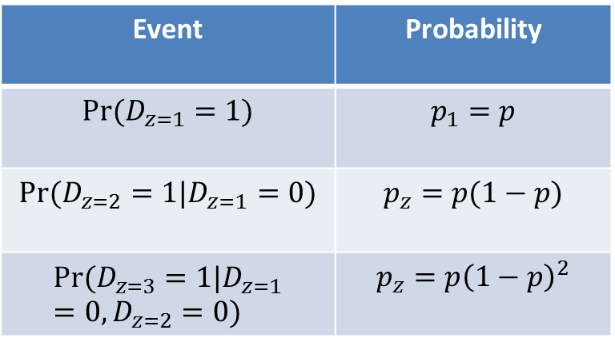
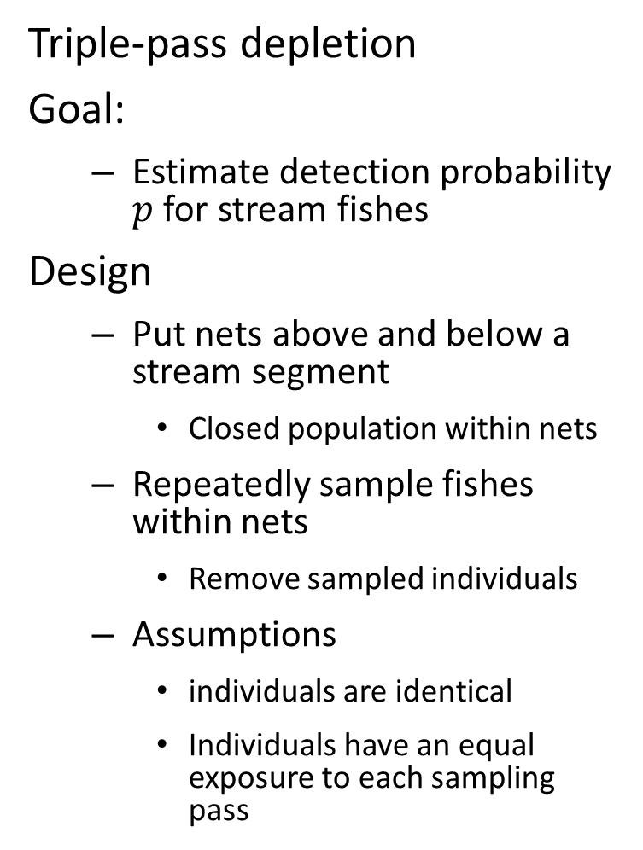
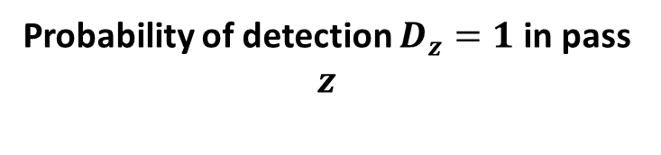
Stream networks
Triple-pass depletion
Goal:
Estimate detection probability $p$ for stream fishes
Design
Put nets above and below a stream segment
Closed population within nets
Repeatedly sample fishes within nets
Remove sampled individuals
Assumptions
individuals are identical
Individuals have an equal exposure to each sampling pass
Probability of detection $D_{z}=1$ in pass $z$
Event | Probability
$$Pr⁡(D_{z=1}=1)$$ | $$p_{1}=p$$
$$Pr⁡(D_{z=2}=1|D_{z=1}=0)$$ | $$p_{z}=p(1−p)$$
$$Pr⁡(D_{z=3}=1|D_{z=1}=0,D_{z=2}=0)$$ | $$p_{z}=p{\left(1−p\right)}^{2}$$

Slide 6
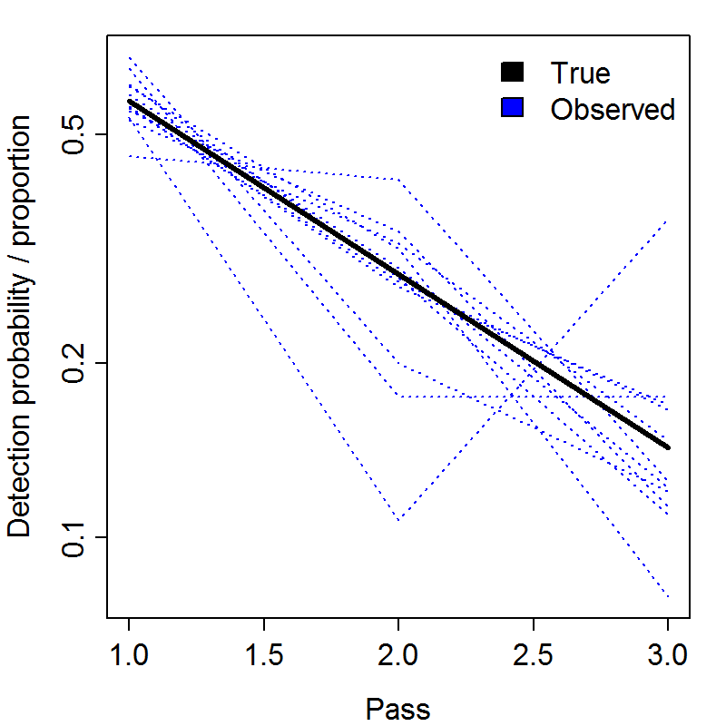
Stream networks
Triple-pass depletion
Probability of detection $D_{z}=1$ in pass $z$
Event | Probability
$$Pr⁡(D_{z=1}=1)$$ | $$p_{1}=p$$
$$Pr⁡(D_{z=2}=1|D_{z=1}=0)$$ | $$p_{z}=p(1−p)$$
$$Pr⁡(D_{z=3}=1|D_{z=1}=0,D_{z=2}=0)$$ | $$p_{z}=p{\left(1−p\right)}^{2}$$

Slide 7
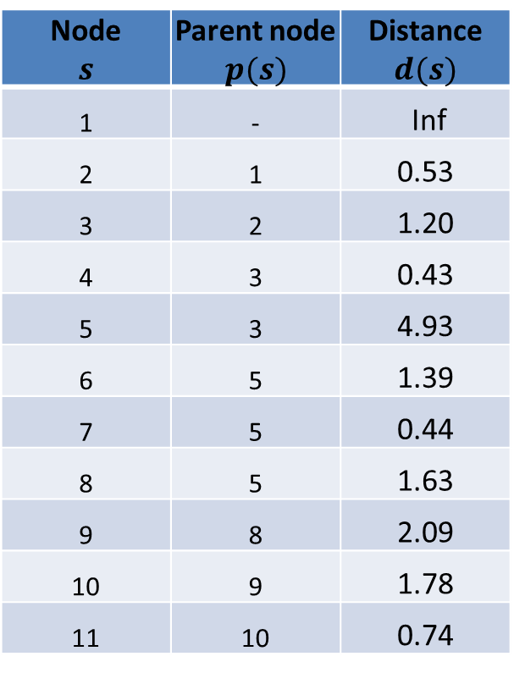
Stream networks
How to define spatial model on streams?
Define an directed acyclic graph (DAG) for network
1
Node $$s$$ | Parent node $$p(s)$$ | Distance $$d(s)$$
1 | - | Inf
2 | 1 | 0.53
3 | 2 | 1.20
4 | 3 | 0.43
5 | 3 | 4.93
6 | 5 | 1.39
7 | 5 | 0.44
8 | 5 | 1.63
9 | 8 | 2.09
10 | 9 | 1.78
11 | 10 | 0.74
11

Slide 8
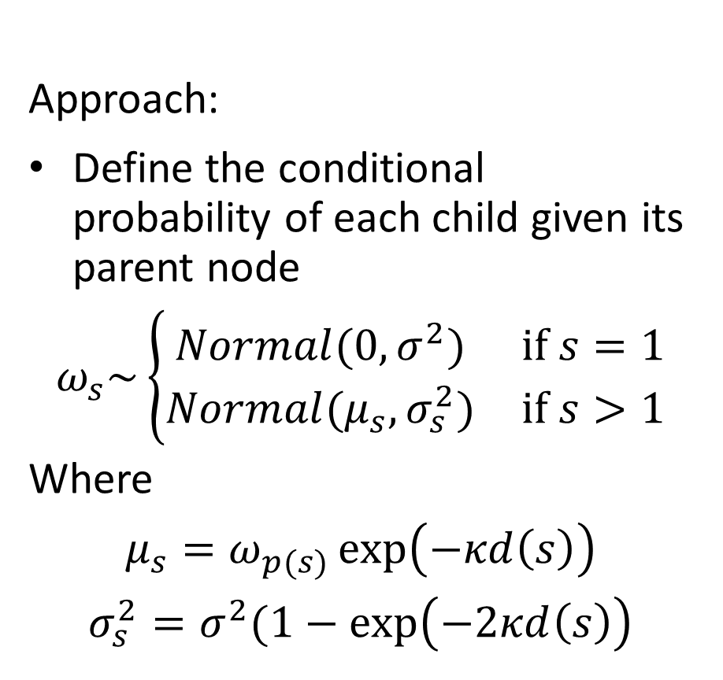
Stream networks
How to define spatial model on streams?
Define an directed acyclic graph (DAG) for network
Approach:
Define the conditional probability of each child given its parent node
$$ω_{s}\sim \left\{\begin{matrix}Normal(0,σ^{2}) & if s=1 \\ Normal(μ_{s},σ_{s}^{2}) & if s>1\end{matrix}\right.$$
Where
$$μ_{s}=ω_{p(s)}\exp\left(−κd\left(s\right)\right)$$
$$σ_{s}^{2}=σ^{2}(1−\exp\left(−2κd\left(s\right)\right)$$
Node $$s$$ | Parent node $$p(s)$$ | Distance $$d(s)$$
1 | - | Inf
2 | 1 | 0.53
3 | 2 | 1.20
4 | 3 | 0.43
5 | 3 | 4.93
6 | 5 | 1.39
7 | 5 | 0.44
8 | 5 | 1.63
9 | 8 | 2.09
10 | 9 | 1.78
11 | 10 | 0.74

Slide 9
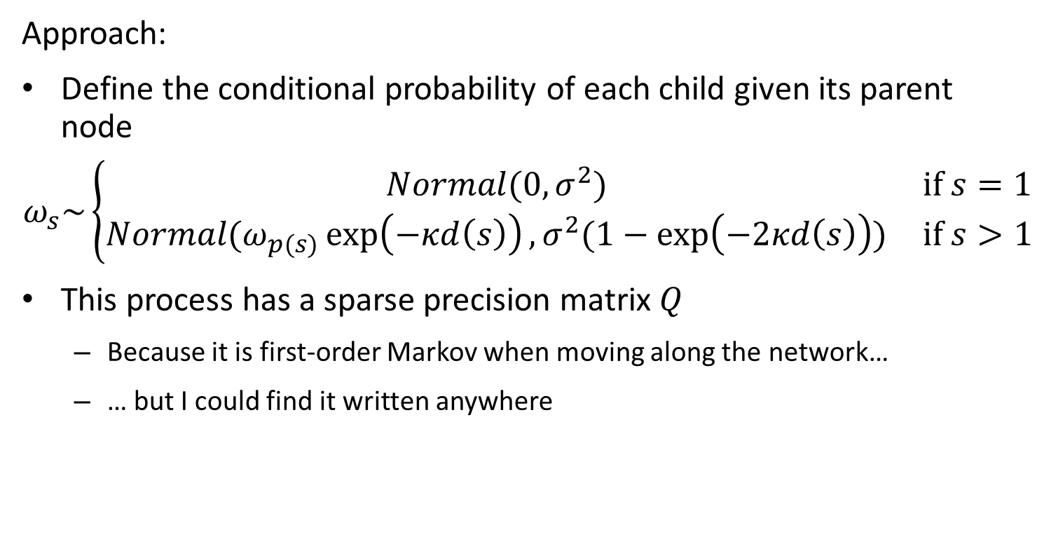
Stream networks
How to define spatial model on streams?
Define an directed acyclic graph (DAG) for network
Approach:
Define the conditional probability of each child given its parent node
$$ω_{s}\sim \left\{\begin{matrix}Normal(0,σ^{2}) & if s=1 \\ Normal(ω_{p(s)}\exp\left(−κd\left(s\right)\right),σ^{2}(1−\exp\left(−2κd\left(s\right)\right)) & if s>1\end{matrix}\right.$$
This process has a sparse precision matrix $Q$
Because it is first-order Markov when moving along the network…
… but I could find it written anywhere

Slide 10
Stream networks
How to define spatial model on streams?
Define an directed acyclic graph (DAG) for network
[see code to check Q calculation using TMB inner hessian]

Slide 11
Stream networks
How to define spatial model on streams?
Define an directed acyclic graph (DAG) for network
[see code to confirm that both approaches give same result]

Slide 12

Stream networks
Exercise
Add spatial variation in detection probability $p$ using stream-network distance

